Slide 1
Sequence Alignment: Investigating an Influenza Outbreak
BIO 300/CMPSC 300
Dr. Kristen Webb
Spring 2016

Slide 2
Descent with Modification
DNA replication ensures a mostly faithful passing of the genome to progeny
What would be the consequence of 100% accurate replication?

Slide 3
Descent with Modification
How does descent with modification happen?

Slide 4
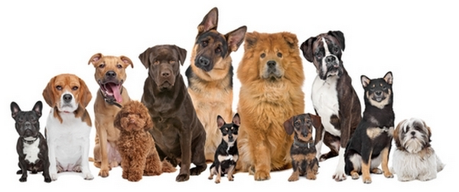
Descent with Modification
How does descent with modification happen?
Mutation
A change in a DNA sequence
Results from errors in replication or repair
Mutation is the ultimate source of genetic variation
Domestic Dog – Canis lupus familiaris
All descendent from the grey wolf
All the same species (sub-species)
Breeds – variation within the species

Slide 5
Sequence Variations
sequences may have diverged from a common ancestor through various types of mutations:
substitutions (ACGA → AGGA)
insertions (ACGA → ACCGGAGA)
deletions (ACGGAGA → AGA)

Slide 6
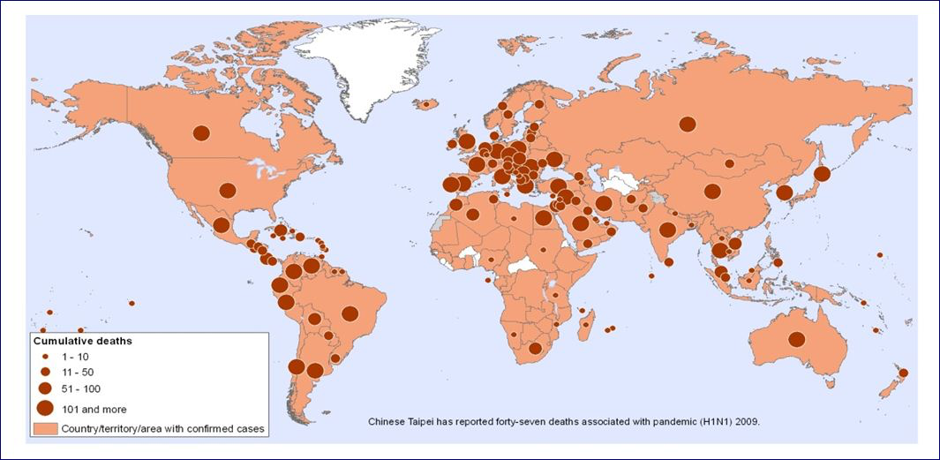
Tracking Infectious Disease – 2009 H₁N₁ Influenza Pandemic

Slide 7
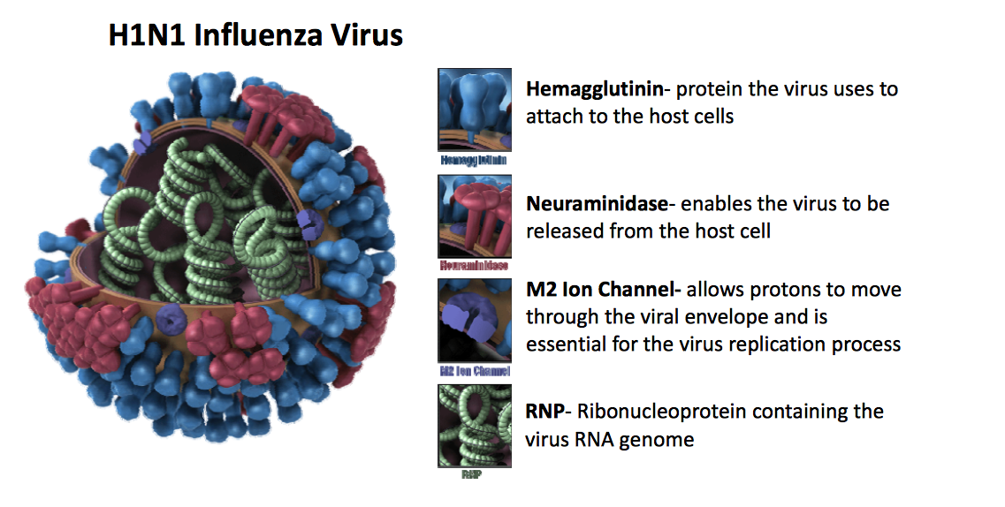
H₁N₁ Influenza Virus

Slide 8
Viral Evolution
Viruses evolve very quickly
Some of the highest mutation rates known
Arms race with immune system
Viruses – mutation rate 0.0001 - 0.000001 mutations per base per generation
One mutation every 10,000 – 1,000,000 nucleotides
Influenza genome size = ~14,000 nucleotides
Entire genome is coding regions (genes)
Humans – 0.00000001 mutations per base per generation
One mutation every 100,000,000 nucleotides
Human genome size 3 billion nucleotides
Only 1.5% of genome is coding regions (genes)

Slide 9
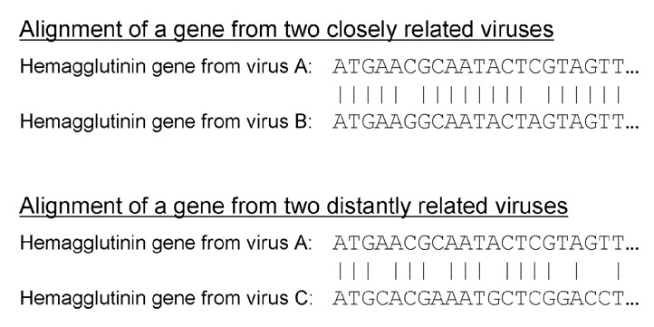
Pairwise Alignment Similarity and Relatedness

Slide 10

Tracing an Infection to a Source - HIV
1990 – CDC report that a women in Florida had contracted HIV from her dentist
Dentist diagnosed with HIV in 1986, developed AIDS in 1987
Patient had no other risk factors and had not been in contact with other HIV-positive persons
Patient had had an invasive dental procedure
Tested dentist’s other patients - 10 tested positive for HIV
Did they contract HIV from the dentist?

Slide 11
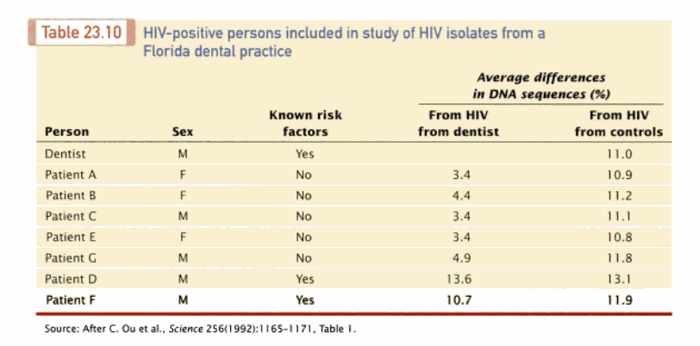
Molecular Epidemiology of HIV Transmission in a Dental Practice

Slide 12
Sequence Aligment
substitutions (ACGA → AGGA)
insertions (ACGA → ACCGGAGA)
deletions (ACGGAGA → AGA)

Slide 13
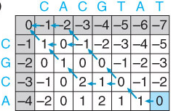
Global Pairwise Alignment
Dynamic Programming
Divide a problem into a series of smaller subproblems
Solve each subproblem
Use the solutions to build the solution to the original problem
Needleman-Wunsch Algorithm
Creates a matrix of partial alignment scores
Backtracks along a path to the best possible alignment

Slide 14
Needleman-Wunsch Algorithm
Create N x M matrix
Place each sequence along one axis
Place score 0 at the up-left corner
Fill in 1st row & column with gap penalty multiples
Fill in the matrix with max value of 3 possible moves:
Vertical move: Score + gap penalty
Horizontal move: Score + gap penalty
Diagonal move: Score + match/mismatch score
The optimal alignment score is in the lower-right corner
To reconstruct the optimal alignment, trace back where the max at each step came from, stop when hit the origin.

Slide 15
Example Alignment score = 0
Let:
Match = +1
Mismatch = 0
Gap = -1
 |  | C | A | C | G | T | A | T
 | 0 | -1 | -2 | -3 | -4 | -5 | -6 | -7
C | -1 | 1 | 0 | -1 | -2 | -3 | -4 | -5
G | -2 | 0 | 1 | 0 | 0 | -1 | -2 | -3
C | -3 | -1 | 0 | 2 | 1 | 0 | -1 | -2
A | -4 | -2 | 0 | 1 | 2 | 1 | 1 | 0

Slide 16
Example Alignment score = 0
Let:
Match = +1
Mismatch = 0
Gap = -1
 |  | C | A | C | G | T | A | T
 | 0 | -1 | -2 | -3 | -4 | -5 | -6 | -7
C | -1 | 1 | 0 | -1 | -2 | -3 | -4 | -5
G | -2 | 0 | 1 | 0 | 0 | -1 | -2 | -3
C | -3 | -1 | 0 | 2 | 1 | 0 | -1 | -2
A | -4 | -2 | 0 | 1 | 2 | 1 | 1 | 0
CACGTAT
--CGCA-

Slide 17
Example Alignment score = 0
Let:
Match = +1
Mismatch = 0
Gap = -1
 |  | C | A | C | G | T | A | T
 | 0 | -1 | -2 | -3 | -4 | -5 | -6 | -7
C | -1 | 1 | 0 | -1 | -2 | -3 | -4 | -5
G | -2 | 0 | 1 | 0 | 0 | -1 | -2 | -3
C | -3 | -1 | 0 | 2 | 1 | 0 | -1 | -2
A | -4 | -2 | 0 | 1 | 2 | 1 | 1 | 0
CACGTAT
C--GCA-

Slide 18
Example Alignment score = 0
Let:
Match = +1
Mismatch = 0
Gap = -1
 |  | C | A | C | G | T | A | T
 | 0 | -1 | -2 | -3 | -4 | -5 | -6 | -7
C | -1 | 1 | 0 | -1 | -2 | -3 | -4 | -5
G | -2 | 0 | 1 | 0 | 0 | -1 | -2 | -3
C | -3 | -1 | 0 | 2 | 1 | 0 | -1 | -2
A | -4 | -2 | 0 | 1 | 2 | 1 | 1 | 0
CACGTAT
CGC--A-

Slide 19
Example Alignment score = 0
Let:
Match = +1
Mismatch = 0
Gap = -1
 |  | C | A | C | G | T | A | T
 | 0 | -1 | -2 | -3 | -4 | -5 | -6 | -7
C | -1 | 1 | 0 | -1 | -2 | -3 | -4 | -5
G | -2 | 0 | 1 | 0 | 0 | -1 | -2 | -3
C | -3 | -1 | 0 | 2 | 1 | 0 | -1 | -2
A | -4 | -2 | 0 | 1 | 2 | 1 | 1 | 0
CACGTAT
--CGCA-
CACGTAT
C--GCA-
CACGTAT
CGC--A-

